Slide 1
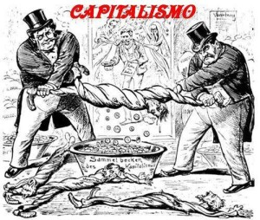
Introduction to Capitalism

Slide 2
Lesson Objectives
To understand the idea of capitalism.
To be able to define the term
To be able to use the term in context of American History.
Information sourced from chapter 4 of Power, Prosperity and Promise

Slide 3
What is Capitalism?
Capitalism: is a socio-economic system that allows private owners to profit from the goods and services they provide.
Can also be referred to as ‘free market economy” or “free enterprise”
Everybody talks about capitalism -- but what is it? | Kajsa Ekis Ekman | TEDxAthens

Slide 4
Background to class division
Historian Karl Marx (1818-1883) - Marx's work in economics laid the basis for much of the current understanding of labour and its relation to capital
He divided people into 2 classes: the Bourgeoisie and the Proletariat.
Bourgeoisie: is the class of ‘modern Capitalists’ – owners of the means of social production and employers of wage labour.
Proletariat: is the class of ‘modern wage labourers’ – no means of production of their own, reduced to selling their labour power in order to live.

Slide 5
Capitalism in America – the beginnings
Marx explored capitalist America in his book Capital, Volume 1 (1867).
He discussed the versatility of the American worker – a result of the lack of restriction on workers moving from one type of job to another (unlike workers in Europe)
Land was cheap and opportunity was great - Australian’s were paying at least 80 times as much for new land.
Idea that anyone could be successful – money was and still is a distinctive feature in American culture.

Slide 6
Capitalism in America – the beginnings
American Workers and capitalists for a time had greater opportunities than people in Europe, as a result of:
Availability of cheap land
Wealth of natural resource (iron, coal, oil)
Cheap labour (exploitation of African Americas, then European/Asian immigrant)
New production techniques
Transport networks using rail and shipping
High tariff barriers 9stop foreign goods flooding the market)

Slide 7
Capitalism in America – the beginnings
However, the greater the success of one group – the more apparent the failure of another.
As American society industrialised/urbanised great poverty become obvious.
Reformers associated with progressivism began to openly ask why the promise of American prosperity was not achieved by all.

Slide 8

Homework Tasks
Complete the American Capitalism Terminology sheet for the next lesson.
Read Introduction to Capitalism worksheet and write a paragraph summary.

